Slide 1
You are your brand
Joed Lopez, MBA
Joedlopez.com
Panvisio.org
Notes:
Open up the video links and get them preloaded Joed…

Slide 2
You are your brand
Things We Will Cover Today
Elements of Branding
How ”Branding” can be used to help build a positive reputation
How to develop your Brand for long-term success
Notes:
Open up the video links and get them preloaded Joed…

Slide 3
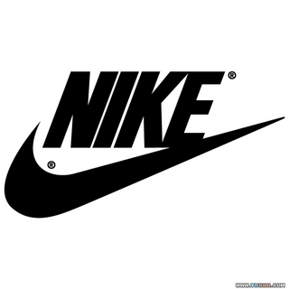
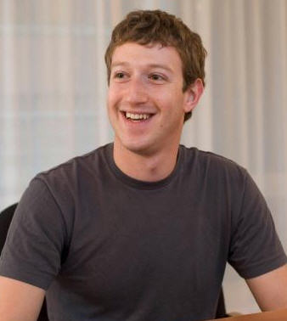
Brand associations & Audit

Slide 4
CMO: Chief Marketing Officer
“You are the Chief Marketing Officer for the brand called you, but what others say about your brand is more impactful than what you say about yourself.”
- Dan Schawbel

Slide 5
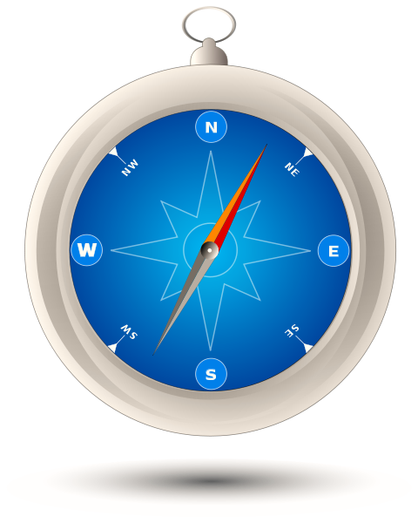
Know your brand!!!
Brand Value
Brand Development
Brand Reputation

Slide 6
Brand Reputation
EXAMPLE
What are the thoughts and feelings people associate with…
Google’s Android?
Apple’s iOS?
Brand Reputation

Slide 7
Brand Reputation
The Psychology of Brand Association
Almost instant
Hard to break
Very powerful
Brand Reputation

Slide 8
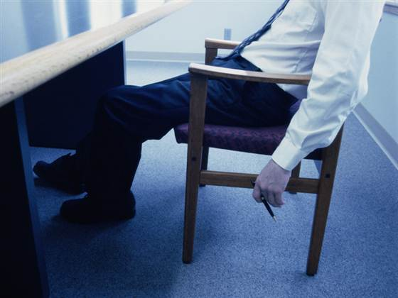
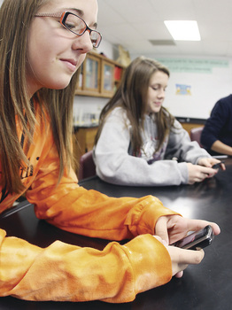
Example: Body language
Image Management & Body Language
Posture impacts emotions
People size you up in 4 seconds or less.
Effective vs. Right
Word Choice!
Enough Said!
Brand Reputation

Slide 9
Brand Reputation Exercise
Activity (5-10 Min.)
What are some of the feelings and characteristics you would like to be known for?
E.g. “I would like to be known as an EOF leader who is (personal character, skill, achievement, service for others)
Brand Reputation

Slide 10
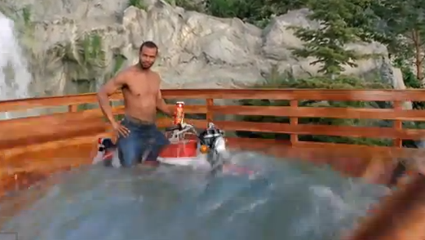
Brand value
Old Spice commercial…seriously?
Brand Value

Slide 11
Brand value
No matter the marketing budget, the product has to do what it claims!
You are your “product”. What is your purpose?
ACTIVITY (5-10 Min.)
What are some of your strengths? (I am creative).
How can they be used to increase your brand value?
E.g. “I want to have a community open mic fundraiser event.”
Brand Value

Slide 12
Brand Development
1st iPad vs. iPad 2
Released close together
2nd totally redesigned and 9x faster
…FOR THE SAME PRICE!
It is about constant improvement and being the best!
Brand Development

Slide 13
Brand Development
You Version 2.0 (Sophomore Year)
SMART Goals
Specific
Measurable
Action Based
Rewarding
Time bound
Brand Development

Slide 14
Brand development Plan
Write down your goals
Keep it in visual place (review daily)
Audio Books
YouTube Videos “How to __________”
Meetup.com
Google/Facebook Groups
Start a Mastermind Group

Slide 15
So, we know its important…but how do we do it?! (continued)
Never stop investing and developing your product!!!
Organizational skills
Time management skills
Critical thinking skills
Feed your mind!

Slide 16
Tools to build your brand!
Wunderlist

Slide 17
Let’s keep in touch! www.joedlopez.com www.panvisio.org lopez.joed@gmail.com @joedlopez1

