Slide 1
Creating your brand.
And Why it Means EVERYTHING for the Direction of your Organization
Joed Lopez B.A. Sociology
Notes:
Open up the video links and get them preloaded Joed…

Slide 2
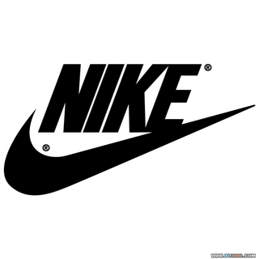
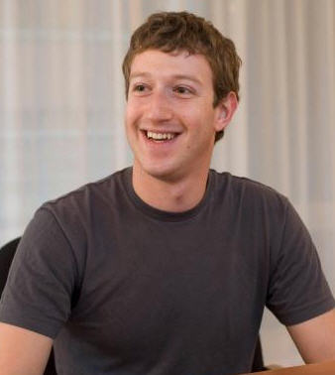
Brand associations & Audit

Slide 3
CMO: Chief Marketing Officer
“You are the chief marketing officer for the brand called you, but what others say about your brand is more impactful than what you say about yourself.”
--Dan Schawbel

Slide 4
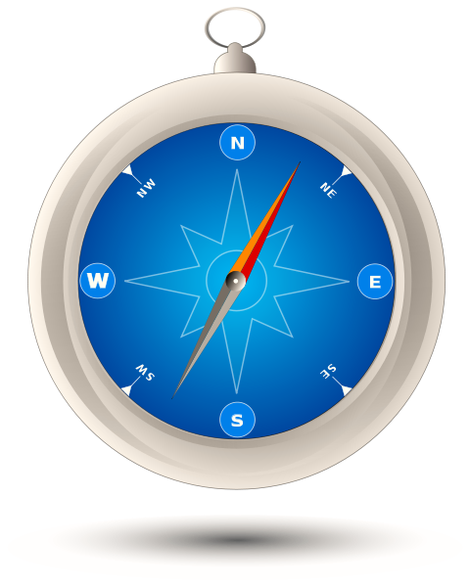
Know your brand!!!
Inspiration
Impact
Identity

Slide 5
Identity
Who are you?
Value System
Align what you say you value and your actions!
What you DON’T value can help you discover this too!

Slide 6
Inspiration
Why should others care?
What is the story?
How does that connect to their story?
What is the best way to share that story?

Slide 7
Impact
What are the actions you take, day to day, to live up to your identity and inspiration?

Slide 8
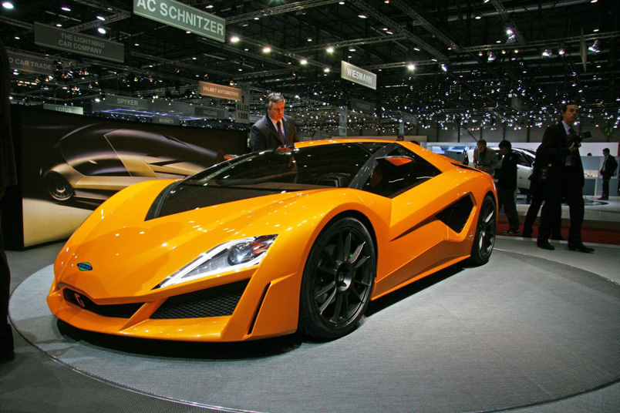
Who made this car?

Slide 9
Who made this car?
General Motors
Acura
Wal-Mart
Knowing all 3 (Identity, Inspiration, Impact) can help you TARGET your ACTIONS in the direction of your GOALS!!!

Slide 10
So, we know its important…but how do we do it?!
Body Image & body language
Posture impacts emotions
People size you up in 4 seconds or less.
Effective vs. Right

Slide 11
So, we know its important…but how do we do it?!
Passive Interaction
Respect others regardless of age, race, culture, religion, title, status, and sexual orientation!
You NEVER know who you may be passing by…
Intentional Interaction
Networking through interests, passions, hobby, major, faith base organization
Exposure to explore. Be apart of things you would never think you would ever be apart of…(polaroid film example).

Slide 12
So, we know its important…but how do we do it?! (continued)
Character Development
“A Game Ratio”
You do what you say!
You think outside of the box to get it done!
You build brand loyalty through your integrity.
Skills & talents mean very LITTLE when NO ONE CAN DEPEND ON YOU!

Slide 13
So, we know its important…but how do we do it?! (continued)
Never stop investing and developing your product!!!
Organizational skills
Time management skills
Critical thinking skills
Feed your mind!

Slide 14
Tools to build your brand!

Slide 15
Tools to build your brand!
Weebly.com
Prezi.com
Vistaprint.com
Linkedin.com
Meetup.com

Slide 16
All This means nothing unless…
….you want it bad enough.
http://www.youtube.com/watch?v=SPf0sClRgrU&feature=related

